Slide 1
Memory Management Unit
Presented by : Vishal Wagh

Slide 2
Content :
Physical and Logical address
Physical Memory
Virtual Memory
Paging
Swapping
Demand Page
Segmentation

Slide 3
Memory allocation :
Memory allocation.
Contiguous Memory allocation.
Static.
Dynamic.
Non-contiguous Memory allocation.
Paging.
Segmentation.

Slide 4
Static memory allocation :
Static that is having fix partition in main memory.
Here all the partition of main memory are same.
2mb
2mb
Fixed size of partition.
2mb
2mb
Main Memory

Slide 5
Dynamic memory allocation :
The main memory is not having fix partition, so the whole main memory is continuous form.
The process dynamically get loaded into the main memory at run time.
3mb
2mb
Different size of partition.
5mb
4mb
Main Memory

Slide 6
Fragmentation :
The extra space that remain in the main memory after all the processes have loaded is called as hole or fragment.
There are two types of fragmentation.
Internal fragmentation.
Internal takes place in static memory allocation.
External fragmentation.
There is a enough memory space to load a new process but as it is not in continuous manner the process can’t be loaded into main memory.

Slide 7
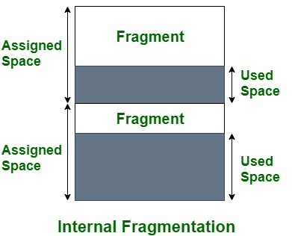
Internal Fragmentation

Slide 8
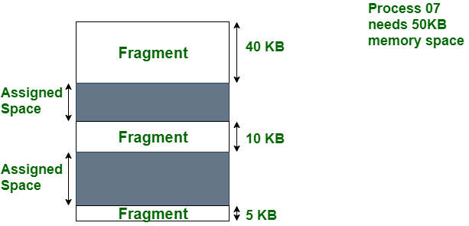
External Fragmentation :

Slide 9
Logical and Physical address
Logical address : It is the address of the program that is generated by cpu.
Physical address : It is the address generated by memory management unit.
Logical address and physical address are same at compile time and load time.
Logical and Physical addresses differ in execution time address-binding scheme.

Slide 10
Swapping :
A process can be swapped temporarily out of memory to a backing store, and then brought back into memory for continued execution.
This phenomena of process switching it’s memory is called as swapping.
It is also called as roll out, roll in.
Swapping variant used for priority-based scheduling algorithms.
Major part of swap time is transfer time

Slide 11
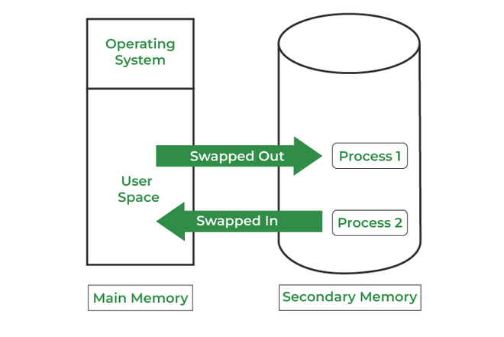
Swapping :

Slide 12
Thank You

